Slide 1




Heart Disease Prediction System Using Machine Learning
Submitted By: Kashish Gupta
PYTHON
SCIKIT-LEARN
STREAMLIT

Slide 2


Problem Statement
A Global Health Crisis
Heart disease is one of the leading causes of death worldwide, claiming millions of lives each year and placing an enormous burden on healthcare systems globally.
The Need for Early Prediction
Early prediction can help healthcare professionals identify high-risk patients and provide timely treatment — potentially saving lives through proactive intervention before symptoms escalate.

Slide 3
Objectives
This project aims to leverage machine learning to build a robust, interpretable heart disease prediction system with a user-friendly interface.
Analyze Dataset
1
Explore and understand the heart disease dataset thoroughly
Build Models
2
Develop predictive machine learning models for classification
Compare Performance
3
Evaluate and compare model accuracy and reliability
Identify Risk Factors
4
Determine the most important clinical risk factors
Patient Interface
5
Develop an interactive patient risk prediction interface

Slide 4
Dataset Description
Features (Clinical Variables)
Target Variable
Additional clinical indicators included in the dataset further enrich the model's ability to detect patterns.
The binary classification target indicates the presence or absence of heart disease:
0
1
No Heart Disease
Heart Disease
Age
Sex
Chest Pain Type
Blood Pressure
Cholesterol
Heart Rate

Slide 5
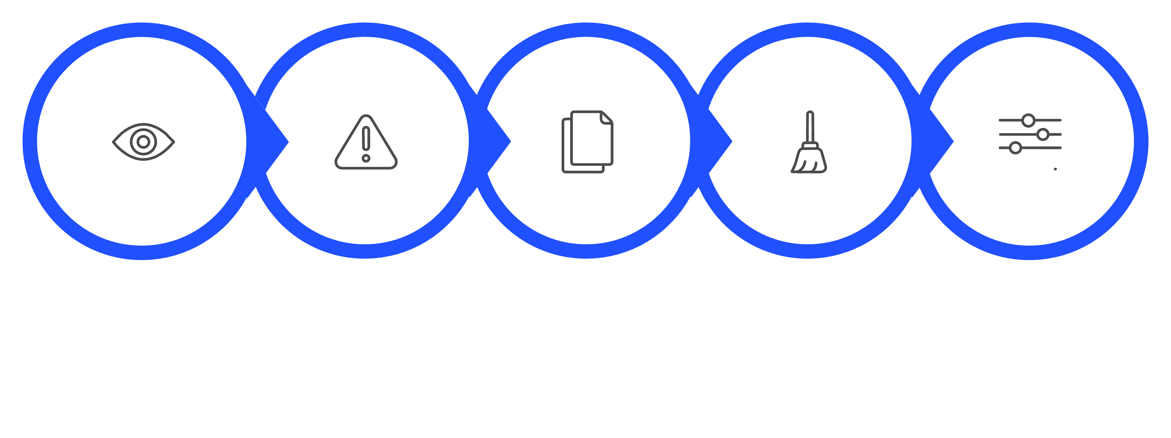
Data Preprocessing
A rigorous preprocessing pipeline ensures data quality and model readiness before training begins.
Missing Analysis
Duplicate Check
Inspect
Clean
Feature Prep
Each step in this pipeline is critical for ensuring the integrity of the dataset and the reliability of the downstream predictive models.

Slide 6




Exploratory Data Analysis
Patient Demographics Analyzed
Age, sex, and population distribution were examined to understand the composition of the dataset and identify any demographic biases.
Disease Distribution Studied
The prevalence of heart disease across different patient groups was analyzed to assess class balance and guide modeling decisions.
Clinical Indicators Explored
Key clinical measurements such as cholesterol, blood pressure, and heart rate were visualized to uncover patterns associated with heart disease.

Slide 7
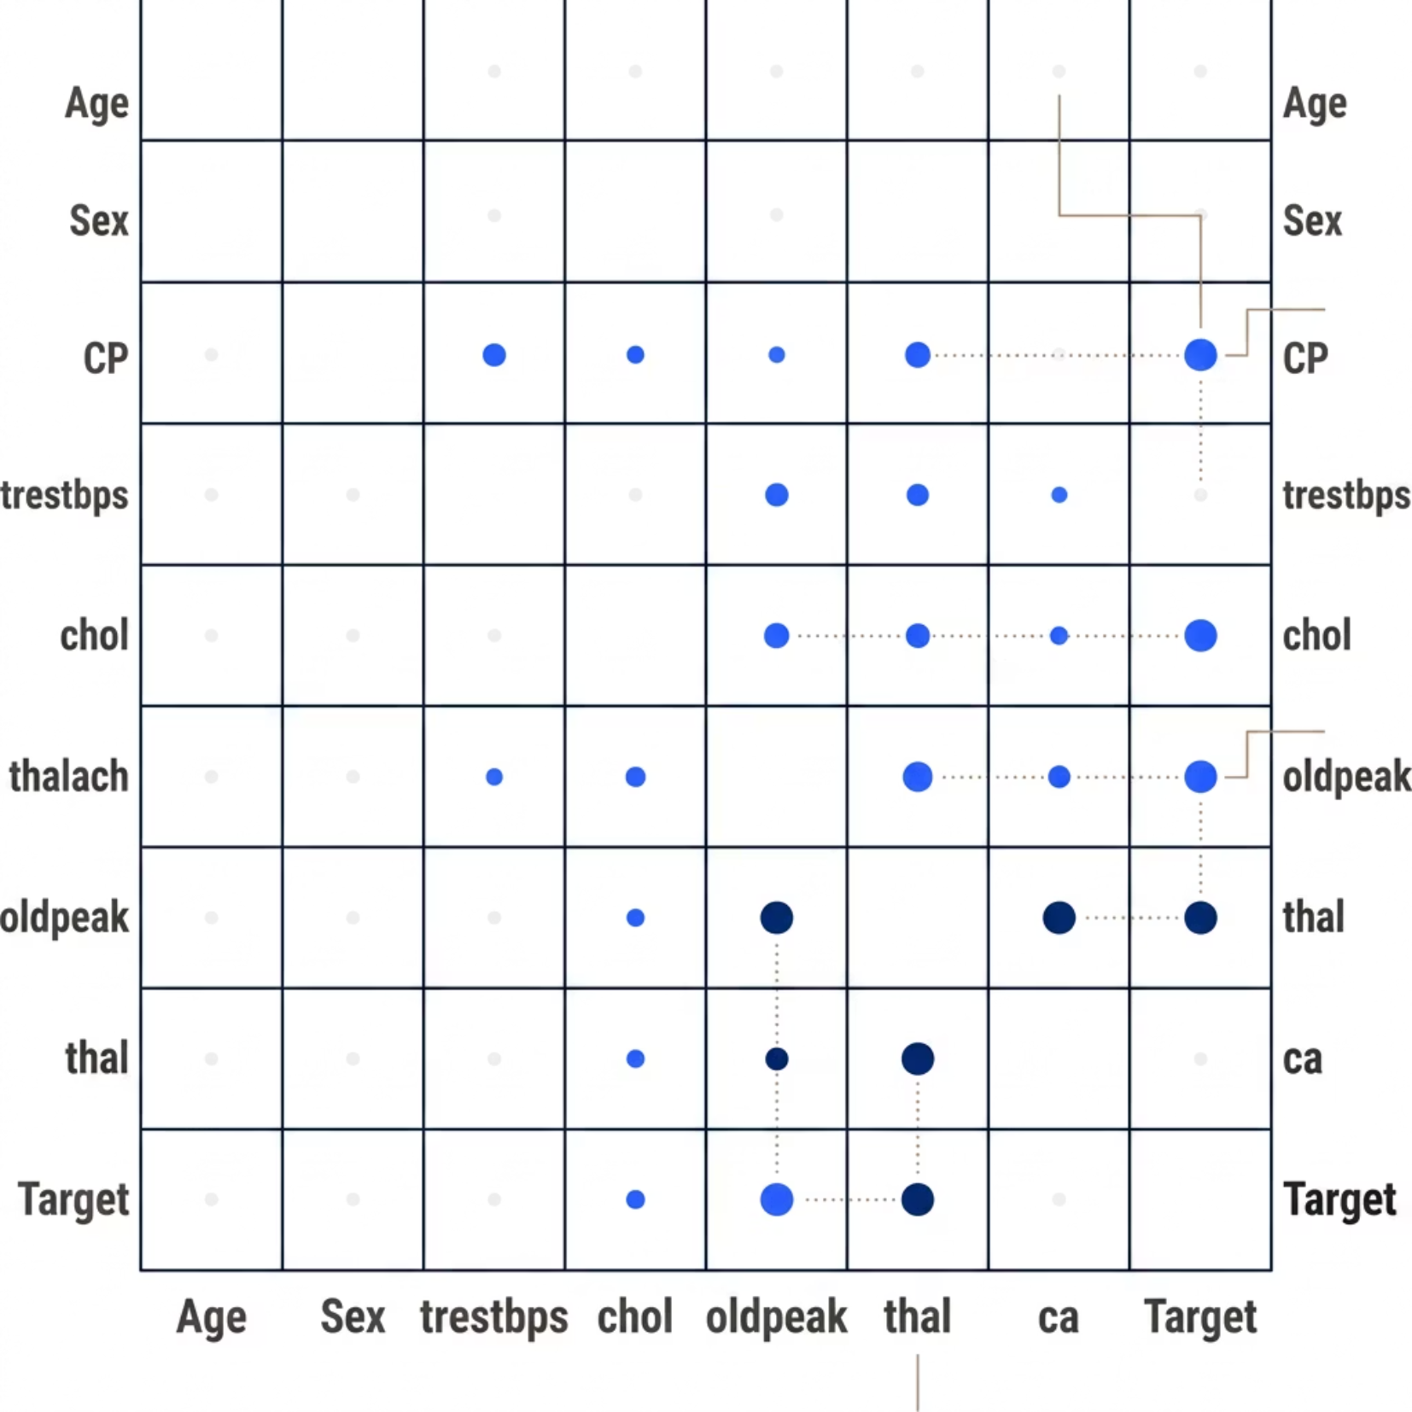

Correlation Heatmap
Why Correlation Analysis?
Correlation analysis was performed to identify relationships among clinical variables, helping to detect multicollinearity and highlight which features are most strongly associated with heart disease presence.
Understanding feature relationships is essential for building interpretable and robust machine learning models.

Slide 8


Model Development
Two complementary machine learning algorithms were selected to provide both interpretability and predictive power.
1. Logistic Regression
2. Random Forest Classifier
A baseline model offering high interpretability. It estimates the probability of heart disease based on linear combinations of clinical features, making it ideal for understanding feature contributions.
An ensemble method that builds multiple decision trees to improve accuracy and reduce overfitting. It handles non-linear relationships and is robust to outliers in clinical data.

Slide 9
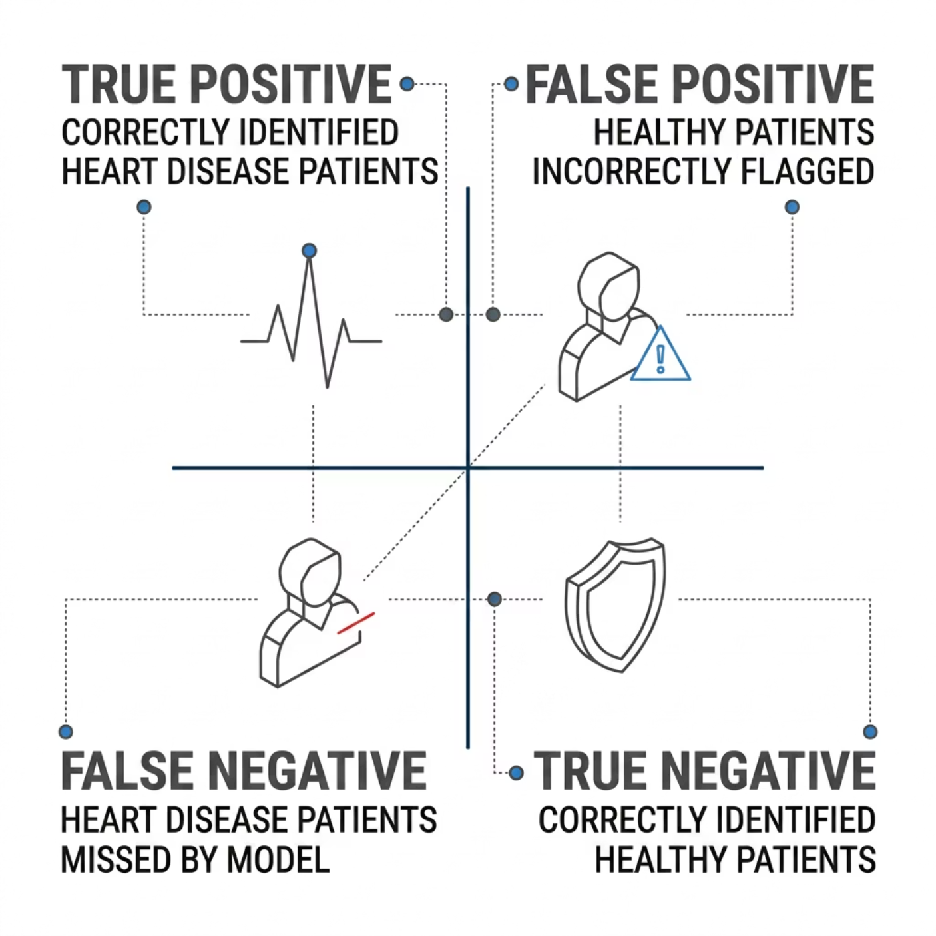
Confusion Matrix
The confusion matrix evaluates how well the model distinguishes between patients with and without heart disease.
Classification Performance
The model successfully classified heart disease and non-heart disease patients, demonstrating strong discriminative ability across both classes.
True Positives
True Negatives
Heart disease correctly detected
Healthy patients correctly cleared

Slide 10






Feature Importance
The Random Forest model identified the following as the top clinical risk factors for heart disease prediction:
thalach
cp
oldpeak
Maximum heart rate achieved
Chest pain type
ST depression induced by exercise
thal
ca
Thalassemia status
Number of major vessels colored by fluoroscopy
These features provide clinically actionable insights, enabling physicians to focus on the most critical indicators during patient assessment.

Slide 11




Streamlit Application
Features:
User-friendly interface
Real-time prediction
Clinical parameter input
Instant risk assessment

Slide 12


Conclusion
Achievements
Results
Deployment
Heart Disease Prediction System developed successfully.
Random Forest achieved strong predictive performance.
Streamlit application deployed locally for patient risk prediction.
Accuracy = 83.61%
ROC-AUC = 87.88%
Thank You

